Slide 1




PRESENTATION BY
TEAM IDEAFORGE
K.GAYATHRI
Y.SRINAGAHANU
B.P.HASINI
B.MUNIMADHAV
P.SUMITH

Slide 2

Moto Mart: Two-Wheeler Marketplace
Team Name- IDEAFORGE
Title : Moto mart
Problem Statement : Vahan Bazar
Team ID- XL0097

Slide 3
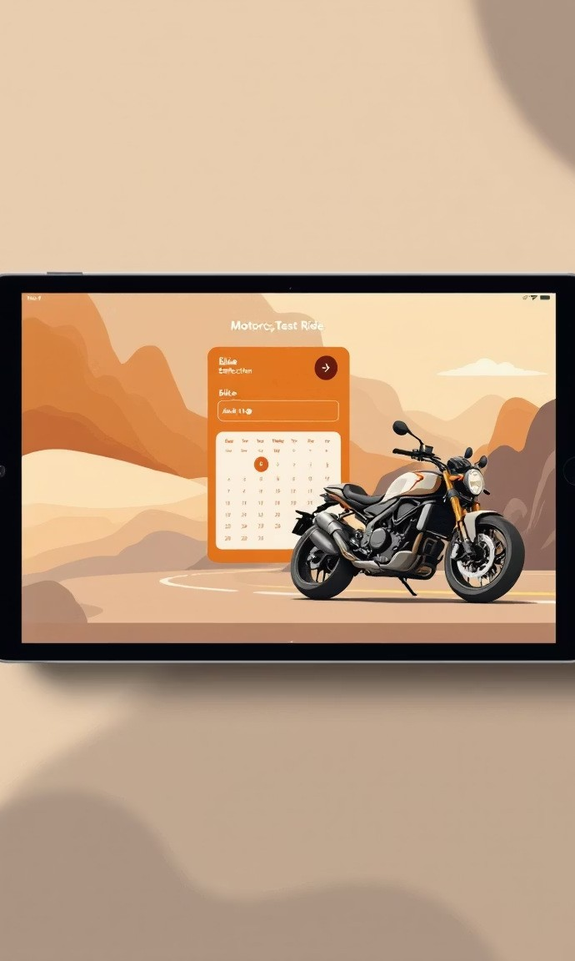
CONTENTS
01.
Introduction to Moto mart
02.
Key Features
03.
Problem Statement
04.
Proposed Solution
05.
Implementation Plan / Roadmap
06.
Languages used and Benefits
07.
Plan of action

Slide 4



01
Introduction to Moto Mart

Slide 5

Introduction to Moto Mart
Moto Mart is a two-wheeler marketplace web app that makes it easy to browse, compare, and buy bikes, scooters, and EVs. Users can search and filter by brand, price, or fuel type, view detailed specifications with images, and even compare models side by side. The app also provides EMI and fuel cost calculators, upcoming launch updates, a showroom directory, and test ride booking options. Sellers can list their used bikes, making Moto Mart a complete platform for both buyers and sellers. With optional features like user accounts, favorites, reviews, price alerts, dealer dashboards, and smart recommendations, Moto Mart offers a simple, transparent, and convenient experience for every two-wheeler enthusiast.

Slide 6






Main Points Today for Buyers & Sellers
Buyer Challenges
Seller Challenges
Buyers currently face numerous challenges, including hopping between various dealerships, outdated listings, hidden charges, and a lack of comparison tools. This results in a time-consuming and frustrating experience.
Sellers struggle with scattered leads, manual inventory management, and a trust deficit. These inefficiencies delay sales, shrink margins, and leave a significant portion of demand unfulfilled, highlighting the need for a unified digital marketplace.

Slide 7
02
Key Features

Slide 8

Browse, Filter, Compare in Seconds
01
02
03
04
Smart Search & Filters
Verified Listings
Eco-Friendly Focus
User-Friendly Interface
Ensures genuine sellers and accurate vehicle details.
Builds trust and reduces fraud risks.
Simple, intuitive design for all age groups.
Works smoothly on both desktop and mobile.
Search by brand, model, price, fuel type, or location.
Saves time and makes browsing effortless.
Promotes electric and hybrid vehicles.
Supports sustainable transportation.

Slide 9


Smart Calculators & Launch Alerts
Integrated Calculators
Integrated EMI, insurance, and fuel-cost calculators provide instant ownership projections using current interest rates and local fuel prices, helping users plan their purchases effectively.
Alerts and Notifications
Users can set budget and feature preferences to receive push alerts on upcoming launches, price drops, and festive offers, ensuring they never miss out on the best deals and opportunities.

Slide 10


Test Ride & Resale in Three Taps
1
Test Ride Booking
Booking test rides with preferred dealerships is quick and easy, with slots synchronized to Google Calendar. Digital KYC reduces paperwork, making the process hassle-free.
Resale Process
2
For resale, owners simply enter their registration number, receive an AI-driven valuation, upload photos, and get doorstep inspection offers. Certified listings fetch higher prices, benefiting both sellers and dealerships.
Convenient Transactions
3
The entire process, from listing to selling, is streamlined and convenient, ensuring that users can complete transactions quickly and efficiently, without any unnecessary delays.

Slide 11
03
Problem statement

Slide 12

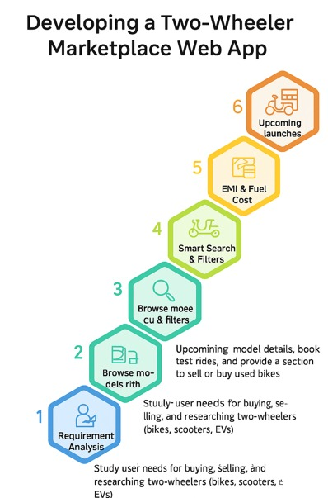
Problem statement
Build a two-wheeler marketplace web app
Build a two-wheeler marketplace web app where users can browse bikes, scooters, and EVs, search and filter by brand, price, or fuel type, view detailed specs with images, compare model's side by side, use EMI and fuel cost calculators, check upcoming launches, explore showrooms, and book test rides or sell used bikes.

Slide 13
04
Proposed Solution

Slide 14

Proposed Solution
Moto Mart provides a one-stop marketplace for two-wheeler buyers and sellers. It simplifies the process by combining browsing, comparison, finance tools, and booking features in a single platform.
Key Solutions
Centralized listings of bikes, scooters, and EVs with specs and images.
Smart search and filters by brand, price, fuel type, or mileage.
Model comparison with side-by-side view.
EMI & fuel cost calculators for better planning.
Showroom directory with test ride booking.
Platform to buy and sell used bikes securely.

Slide 15
05
Implementation Plan / Roadmap

Slide 16

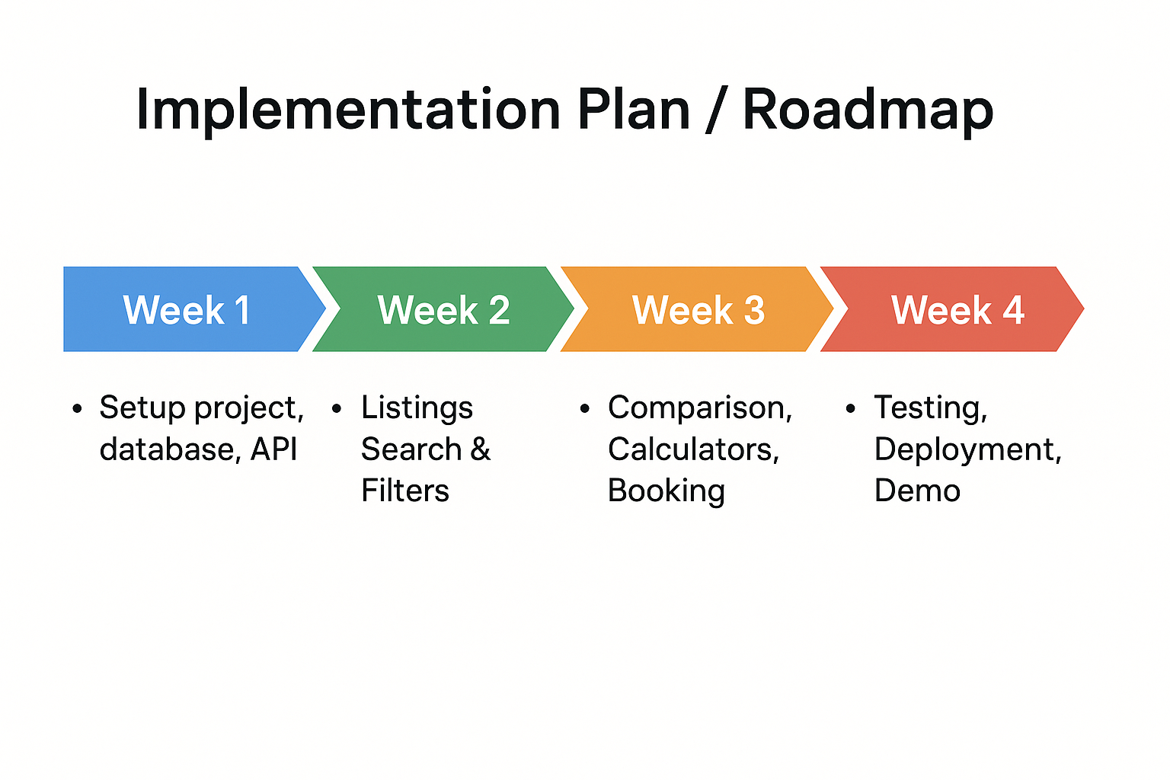
Implementation Plan /
Roadmap

Slide 17
06
Languages used and Benefits

Slide 18

Languages
Front-End
Back-End
Database
The front-end is built using React, delivering a Progressive Web App (PWA) with server-side rendering for optimal SEO performance. Redux manages filter states, ensuring a smooth and responsive user interface.
Node.js microservices handle authentication and listings, payments, and notifications, ensuring a scalable and efficient backend architecture that can handle high traffic and complex operations.
PostgreSQL is used for transactional data storage, with JSONB columns for flexible specifications. Redis caching optimizes performance for frequently accessed data, ensuring fast load times even during peak usage.

Slide 19



Benefits
01
02
For Buyers
For sellers
Wider reach beyond local markets.
Quick and hassle-free listing process.
Better chances of getting fair market value.
Direct contact with genuine buyers (no middlemen).
Wide variety of vehicles at one place (new, used, rentals).
Transparent pricing with no hidden charges.
Verified sellers ensure safe and trustworthy deals.

Slide 20

Rider Growth & Revenue Levers
1
2
3
Urban Rider Acquisition
Revenue Streams
Growth Metrics
Acquire urban riders through strategic partnerships with YouTube reviewers, college festivals, and EV expos. Referral credits and zero-cost EMI options lower purchase barriers and drive engagement.
Revenue streams include dealer subscriptions, featured listings, loan facilitation fees, and insurance commissions. The goal is to achieve an average transaction revenue of 4% within 18 months.
Track key metrics such as monthly completed transactions, average days-to-sell, dealer NPS, and buyer repeat rate. Use real-time dashboards to monitor funnel performance and optimize conversion rates.

Slide 21
07
Plan of action

Slide 22

Plan of action for Moto Mart
The Moto Mart project will start with designing screens like home, listings, product details, comparison, and booking forms.We will set up the project using React for frontend, Django for backend, and PostgreSQL for database.Core features will include bike/scooter listings, search and filters, product details, and model comparison.We will add EMI and fuel cost calculators, used bikes section, showroom directory, and test ride booking.Upcoming launches with prices and dates will also be displayed.Optional features like login, favorites, reviews, price alerts, and dealer dashboards can be added later.Finally, the app will be optimized, tested, deployed online, and improved based on user feedback.
\

Slide 23

THANK YOU ！

